Slide 1
Alzheimer’s Disease Classification from MRI Scans Using Convolutional Neural Networks
Presented By
Name: MUSKAN MAHATO
Institute: BIT,Sindri
Department: CSE(Data Sciences)
Group Name: MS AI - AICTE - April2025
Gmail ID: muskanmahato1234@gmail.com
AICTE Student ID: STU63404664cf2b91665156708

Slide 2
PROBLEM STATEMENT
Alzheimer’s disease is a progressive neurological disorder that causes memory loss and cognitive decline. Diagnosing it accurately at an early stage is essential but challenging due to the complexity of MRI analysis. Manual interpretation is time-consuming, error-prone, and requires expert knowledge, making it difficult to efficiently identify and differentiate between the varying stages of the disease.

Slide 3
PROPOSED SOLUTION
To address the challenges of early and accurate diagnosis of Alzheimer’s disease, the proposed solution is an automated classification system powered by deep learning.This system uses Convolutional Neural Networks (CNNs) to process and classify MRI brain images into four categories: Non-Demented, Very Mild Demented, Mild Demented, and Moderate Demented.Key Components:Image Processing: Structural MRI images are preprocessed and normalized for feature extraction.CNN Model: A deep learning model trained to learn patterns distinguishing the stages of Alzheimer’s.Training & Validation: Utilizes labeled datasets, validating model performance and accuracy.Testing: Evaluated on unseen data to ensure robustness and generalization.Goal: To reduce reliance on manual MRI analysis, improve diagnostic accuracy, and provide a scalable, efficient support tool for healthcare professionals.

Slide 4
SYSTEM APPROACH
System Requirements:
A system with Python 3.7+, at least 8GB RAM, GPU for faster training, and a modern IDE like Google Colab ,Jupyter Notebook or VS Code.
01
Libraries Required to Build the Model:
TensorFlow, Keras, NumPy, Pandas, Matplotlib, Seaborn, scikit-learn, and OpenCV for image processing and deep learning model implementation.
02

Slide 5
ALGORITHM & DEPLOYMENT
1. Algorithm Selection: A Convolutional Neural Network (CNN) was chosen due to its excellent performance in image classification tasks. It automatically learns spatial hierarchies and patterns in MRI images, which is ideal for detecting Alzheimer’s disease stages.
2. Data Input: The model takes preprocessed grayscale MRI images (128×128) as input. Labels include four classes: Non-Demented, Very Mild, Mild, and Moderate Demented.
3. Training Process:The CNN was trained using labeled MRI datasets, with image normalization and augmentation. Techniques like dropout and batch normalization were applied, and validation data was used for performance monitoring.
4. Prediction Process:The trained model predicts Alzheimer’s stage on new unseen MRI images by outputting class probabilities and selecting the class with the highest score.

Slide 6
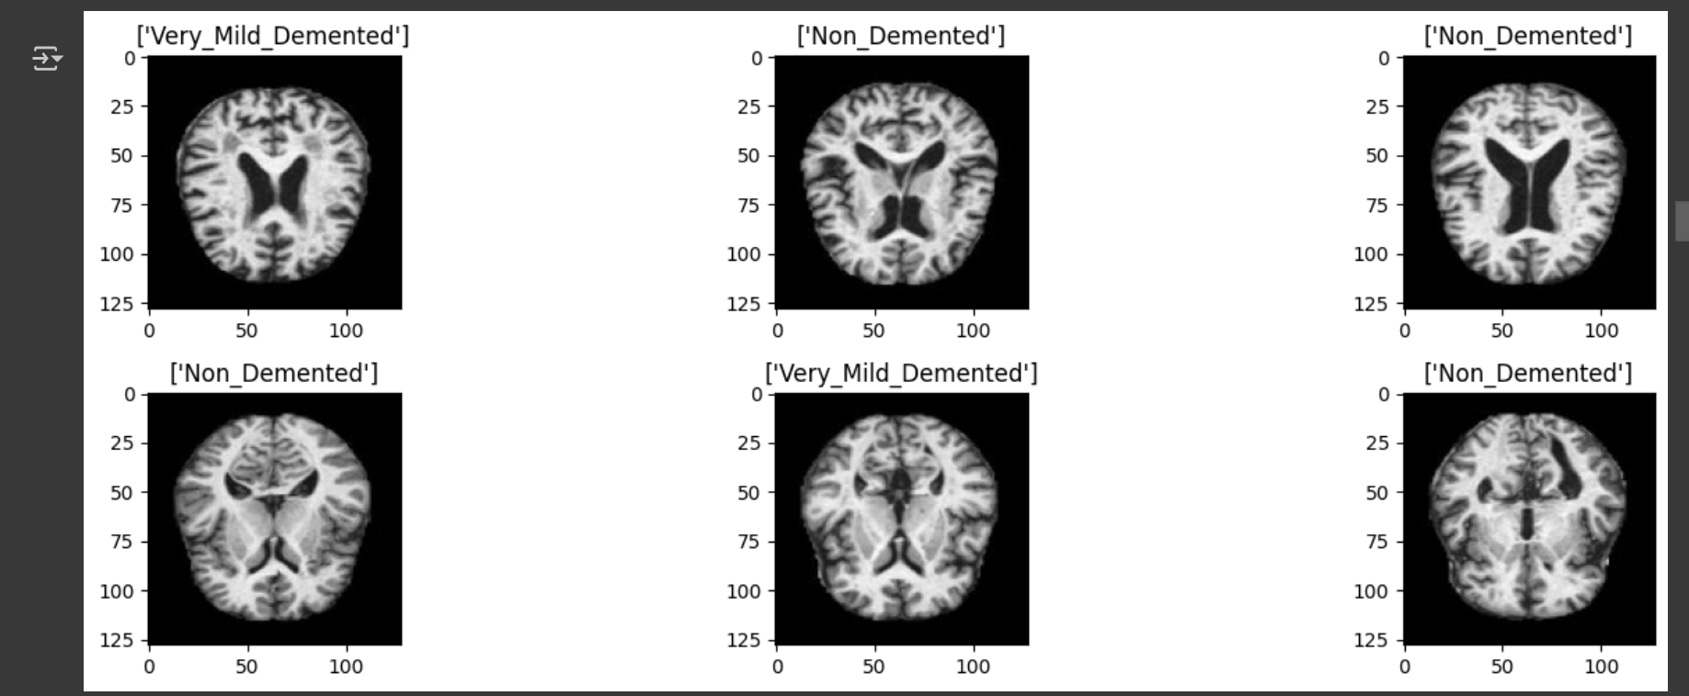
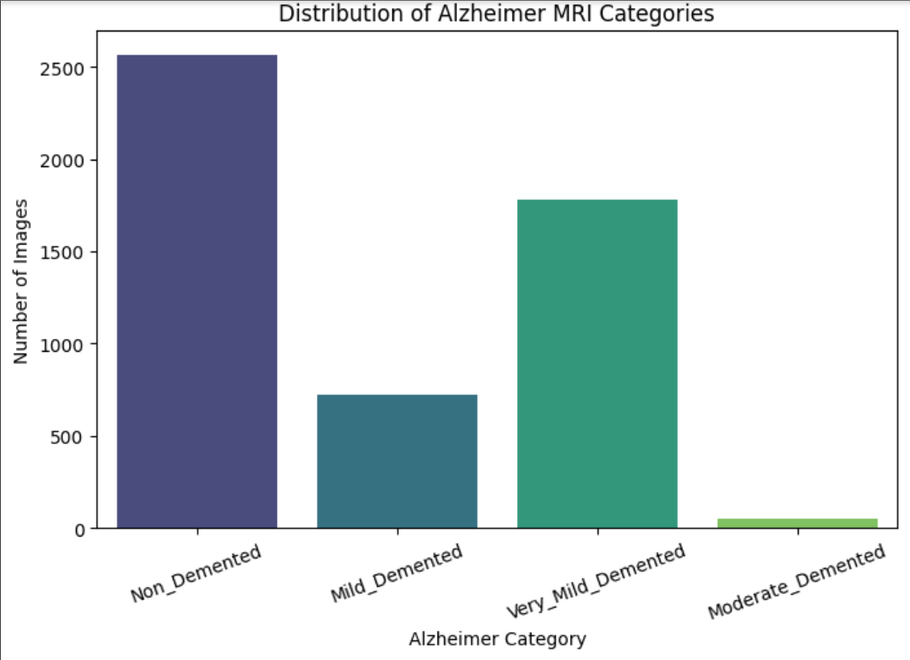
RESULT/OUTPUT

Slide 7
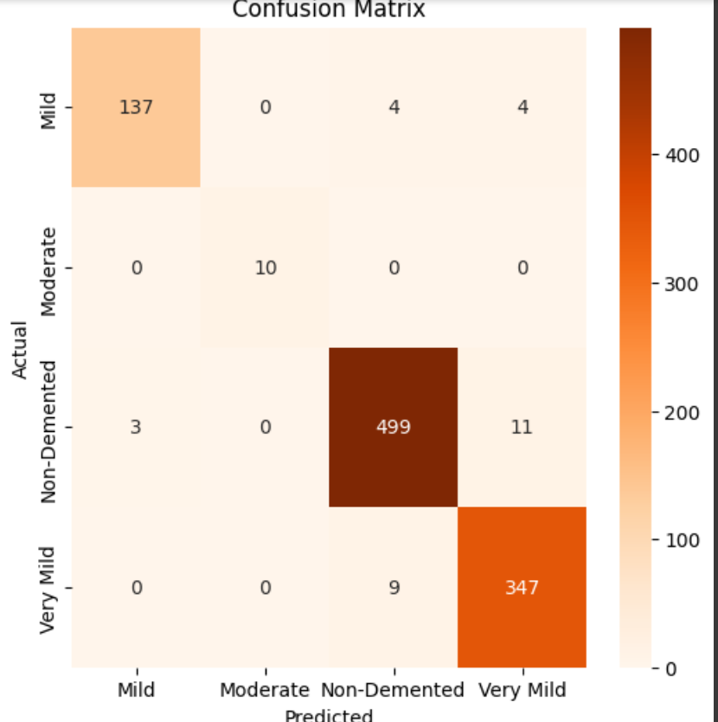
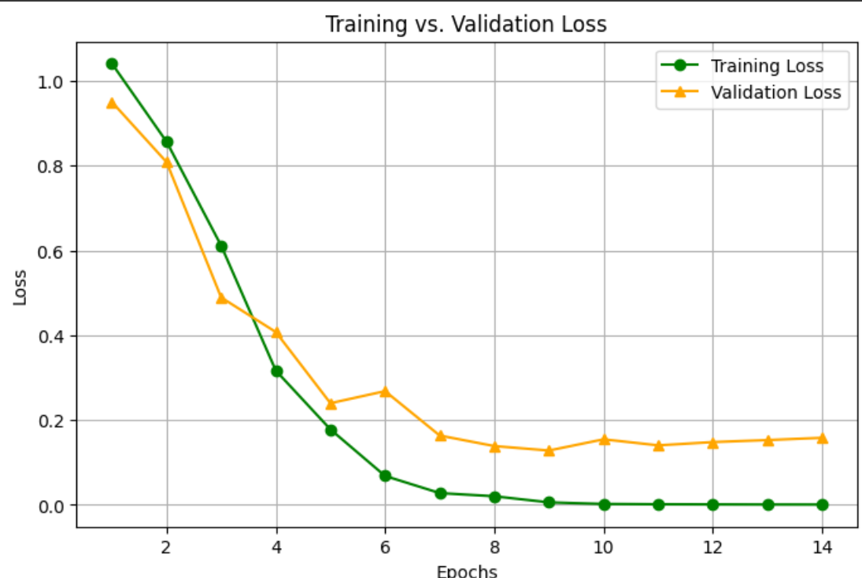
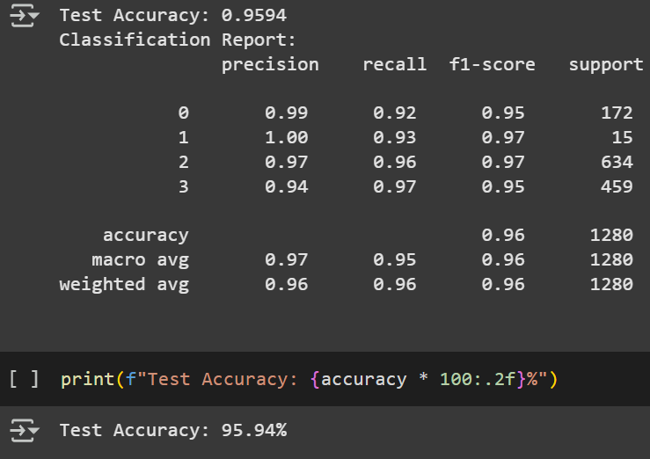

Slide 8
CONCLUSION
This project successfully developed a CNN-based model to classify Alzheimer’s disease stages from MRI images. Despite moderate accuracy due to limited data or class imbalance, the model demonstrates the potential of deep learning in medical diagnostics. Challenges included low generalization on unseen data. Future improvements may involve data augmentation, advanced architectures, and better preprocessing for enhanced diagnostic accuracy.

Slide 9
FUTURE SCOPE
The system can be enhanced by incorporating larger and more diverse MRI datasets to improve model generalization. Advanced deep learning techniques like transfer learning or ensemble models can be employed for better performance. Integration with clinical decision support systems and edge computing can enable real-time diagnosis. Additionally, expanding the model to detect other neurological disorders can make it a more comprehensive diagnostic tool in healthcare.

Slide 10
REFERENCES
1.Sarraf, S., & Tofighi, G. (2016). Deep learning-based pipeline to recognize Alzheimer's disease using fMRI data. Stanford University.
2.Wang, S. H., et al. (2019). Alzheimer's Disease detection using convolutional neural networks and MRI scans. Neurocomputing, 329, 195–203.
3.Gupta, A., Ayhan, M. S., & Maida, A. (2013). Natural image bases to represent neuroimaging data. International Conference on Machine Learning (ICML).
4.Alzheimer's Disease Neuroimaging Initiative (ADNI) – http://adni.loni.usc.edu
5.Chollet, F. (2015). Keras: Deep Learning library for Theano and TensorFlow. GitHub repository
6.Scikit-learn: Machine Learning in Python – https://scikit-learn.org
GitHubLink:https://github.com/MuskanMahato26/Alzheimer-s-Disease-Classification-from-MRI-Scans-Using-Convolutional-Neural-Networks

Slide 11
THANK YOU!

